Slide 1
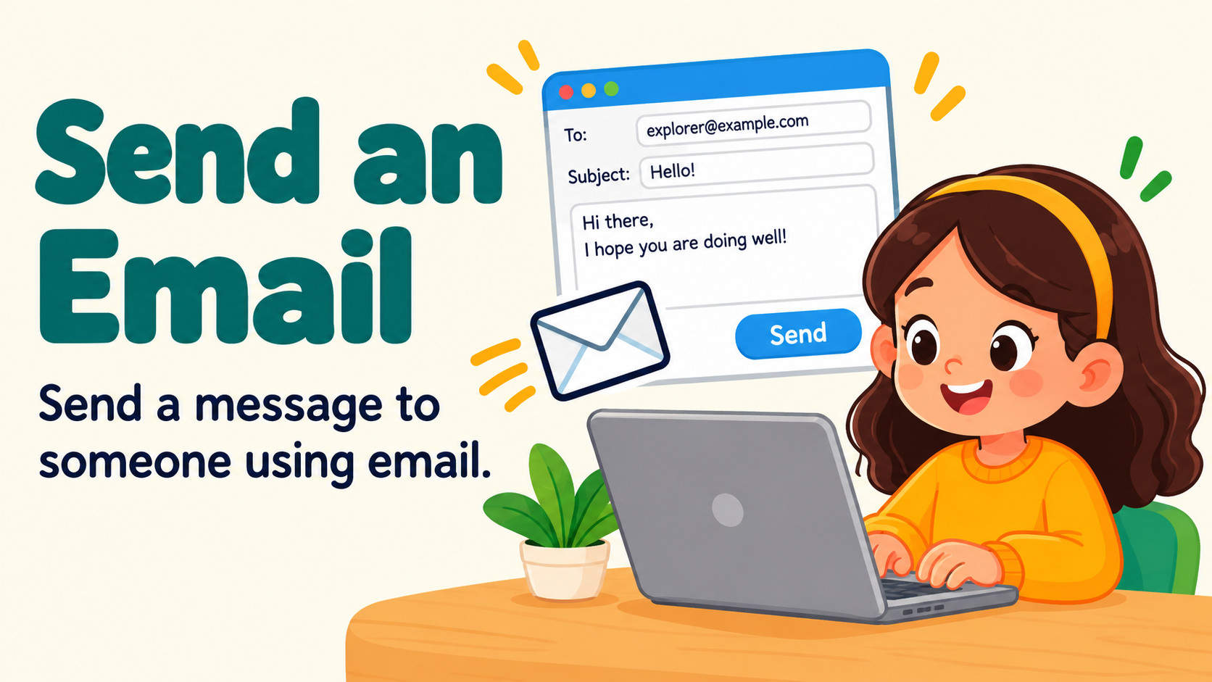
Notes:
Source: Oxford International Primary Computing Student Book 3, Unit 2 Digital literacy: Explorers, section 2.3 Send an email, printed pages 26–27, and section 2.4 Open an email, pages 28–29. Classroom adaptation. Illustrations are generated teaching examples. Practice address example.com is illustrative only.

Slide 2

Notes:
Source: Oxford International Primary Computing Student Book 3, Unit 2 Digital literacy: Explorers, section 2.3 Send an email, printed pages 26–27, and section 2.4 Open an email, pages 28–29. Classroom adaptation. Illustrations are generated teaching examples. Practice address example.com is illustrative only.

Slide 3

Notes:
Source: Oxford International Primary Computing Student Book 3, Unit 2 Digital literacy: Explorers, section 2.3 Send an email, printed pages 26–27, and section 2.4 Open an email, pages 28–29. Classroom adaptation. Illustrations are generated teaching examples. Practice address example.com is illustrative only.

Slide 4
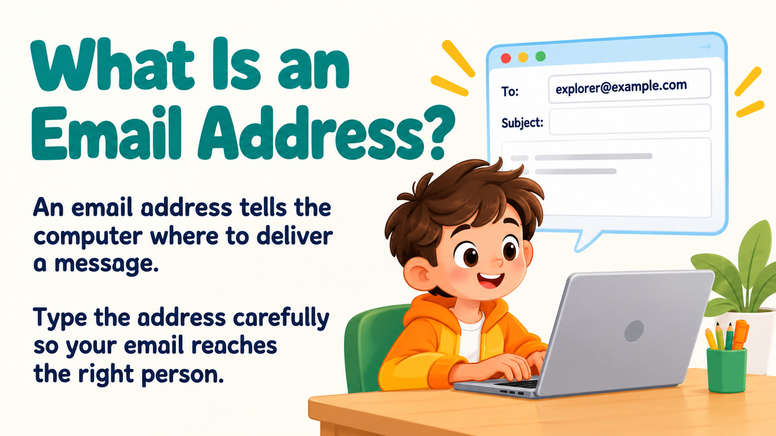
Notes:
Source: Oxford International Primary Computing Student Book 3, Unit 2 Digital literacy: Explorers, section 2.3 Send an email, printed pages 26–27, and section 2.4 Open an email, pages 28–29. Classroom adaptation. Illustrations are generated teaching examples. Practice address example.com is illustrative only.

Slide 5

Notes:
Source: Oxford International Primary Computing Student Book 3, Unit 2 Digital literacy: Explorers, section 2.3 Send an email, printed pages 26–27, and section 2.4 Open an email, pages 28–29. Classroom adaptation. Illustrations are generated teaching examples. Practice address example.com is illustrative only.

Slide 6

Notes:
Source: Oxford International Primary Computing Student Book 3, Unit 2 Digital literacy: Explorers, section 2.3 Send an email, printed pages 26–27, and section 2.4 Open an email, pages 28–29. Classroom adaptation. Illustrations are generated teaching examples. Practice address example.com is illustrative only.

Slide 7

Notes:
Source: Oxford International Primary Computing Student Book 3, Unit 2 Digital literacy: Explorers, section 2.3 Send an email, printed pages 26–27, and section 2.4 Open an email, pages 28–29. Classroom adaptation. Illustrations are generated teaching examples. Practice address example.com is illustrative only.

Slide 8

Notes:
Source: Oxford International Primary Computing Student Book 3, Unit 2 Digital literacy: Explorers, section 2.3 Send an email, printed pages 26–27, and section 2.4 Open an email, pages 28–29. Classroom adaptation. Illustrations are generated teaching examples. Practice address example.com is illustrative only.

Slide 9
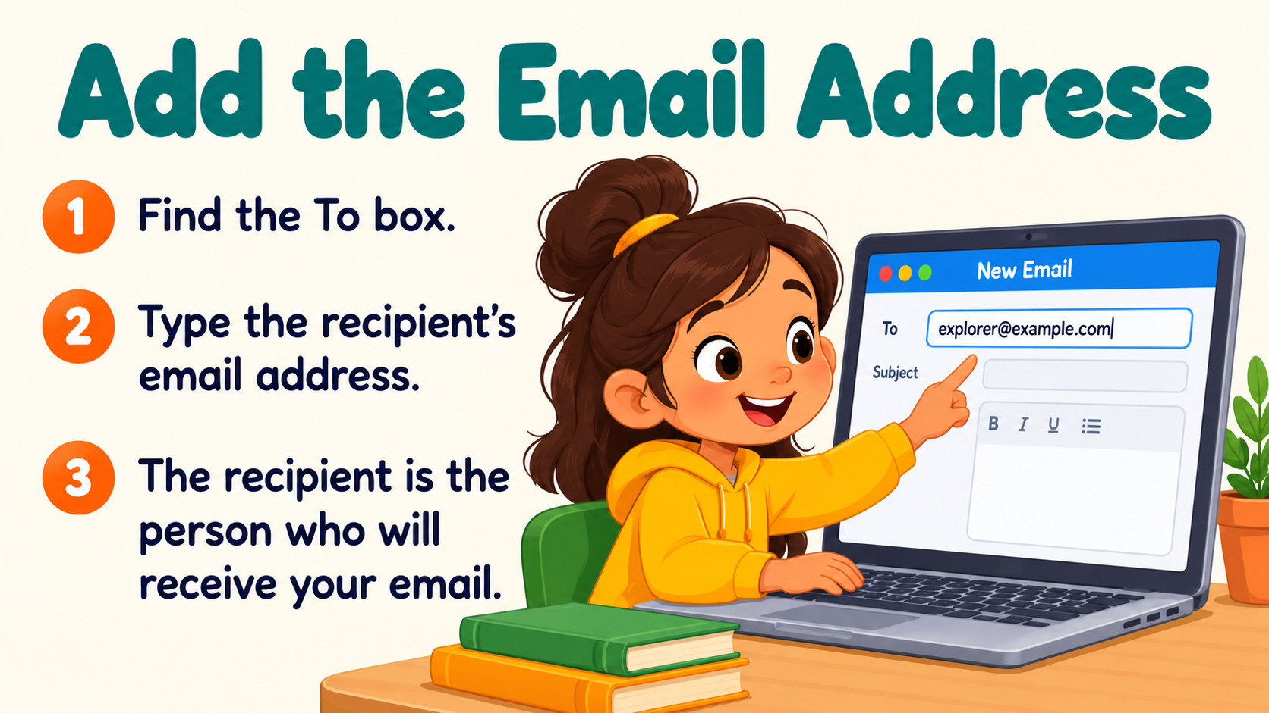
Notes:
Source: Oxford International Primary Computing Student Book 3, Unit 2 Digital literacy: Explorers, section 2.3 Send an email, printed pages 26–27, and section 2.4 Open an email, pages 28–29. Classroom adaptation. Illustrations are generated teaching examples. Practice address example.com is illustrative only.

Slide 10
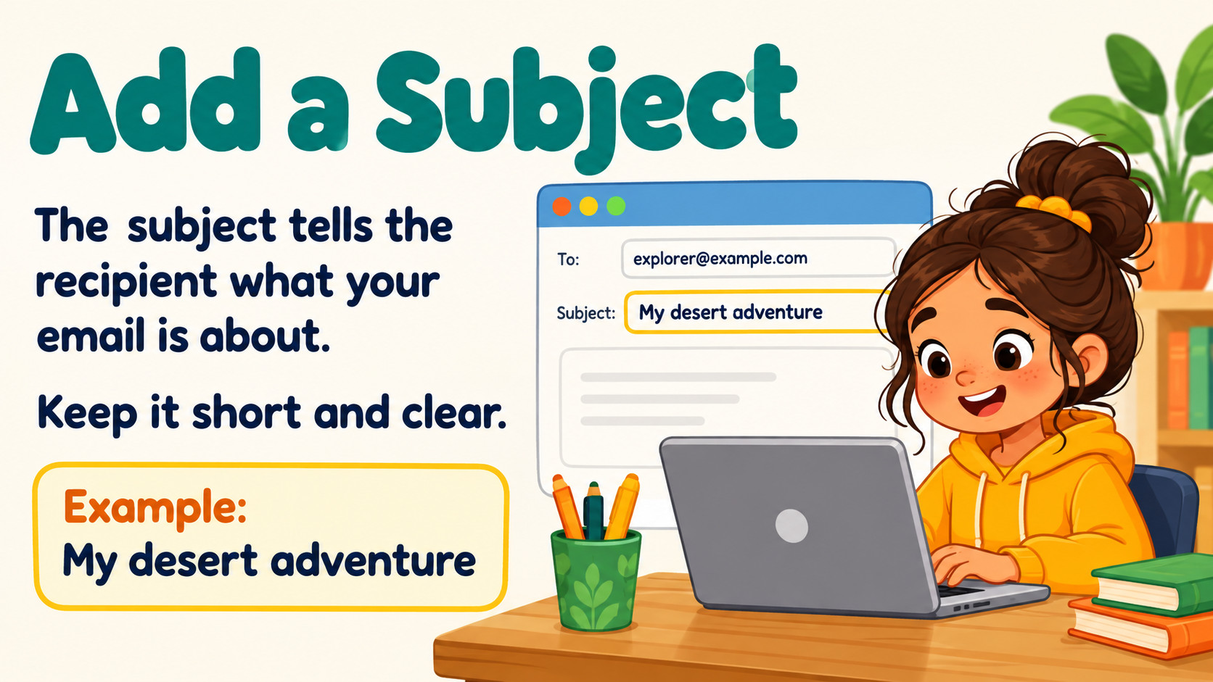
Notes:
Source: Oxford International Primary Computing Student Book 3, Unit 2 Digital literacy: Explorers, section 2.3 Send an email, printed pages 26–27, and section 2.4 Open an email, pages 28–29. Classroom adaptation. Illustrations are generated teaching examples. Practice address example.com is illustrative only.

Slide 11
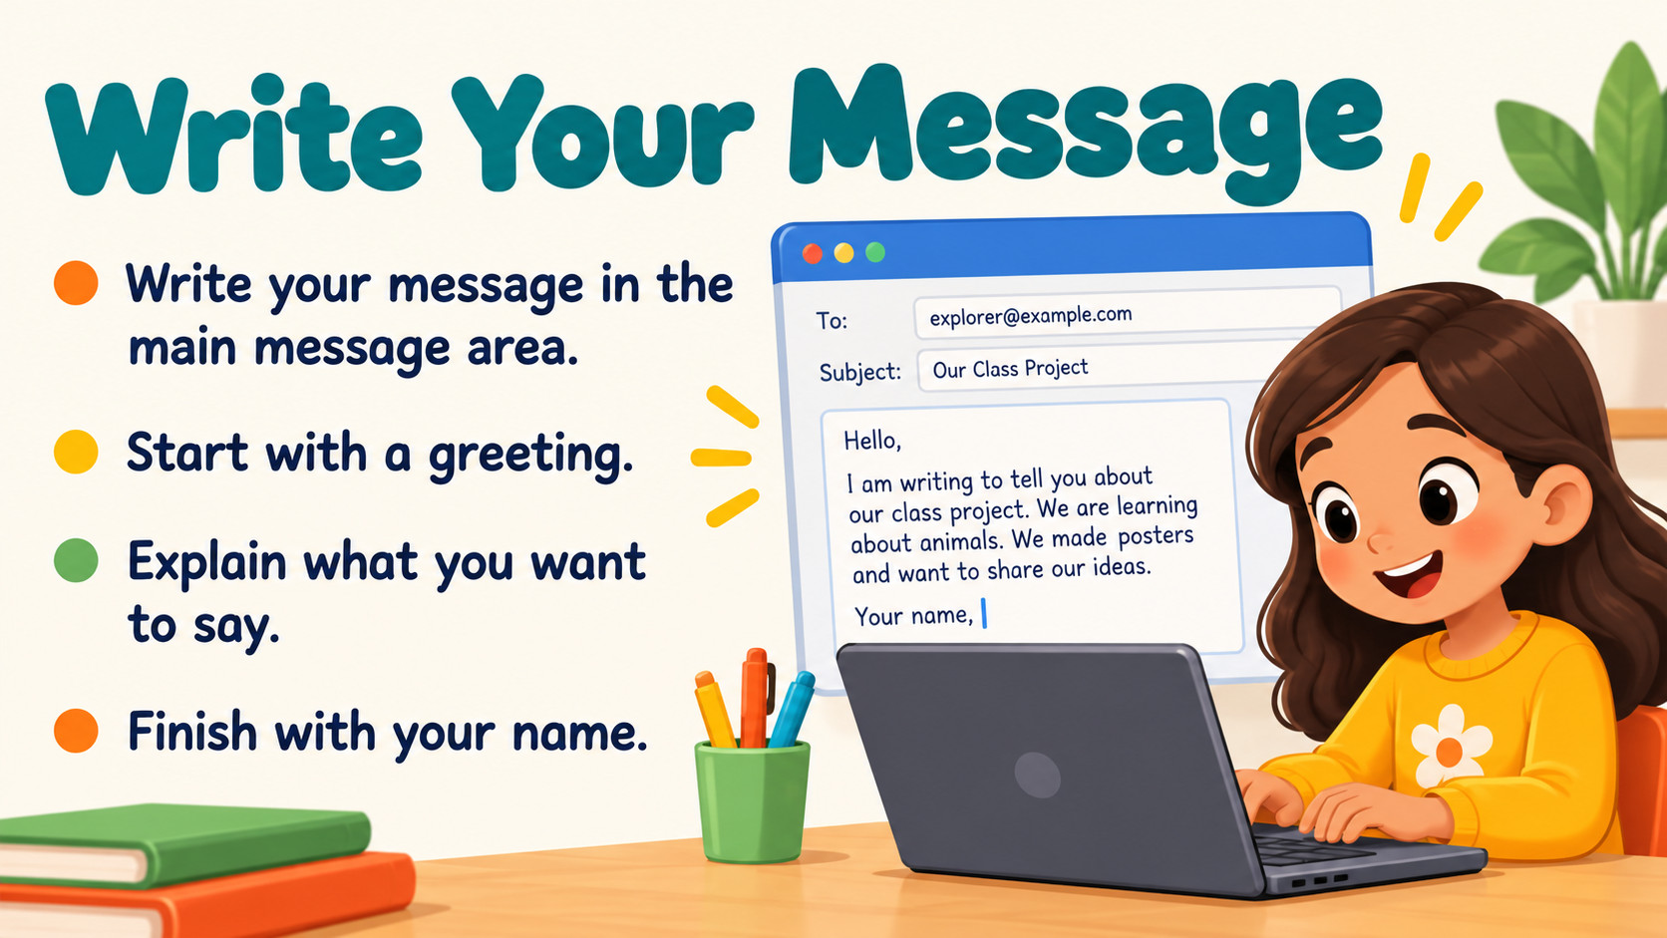
Notes:
Source: Oxford International Primary Computing Student Book 3, Unit 2 Digital literacy: Explorers, section 2.3 Send an email, printed pages 26–27, and section 2.4 Open an email, pages 28–29. Classroom adaptation. Illustrations are generated teaching examples. Practice address example.com is illustrative only.

Slide 12
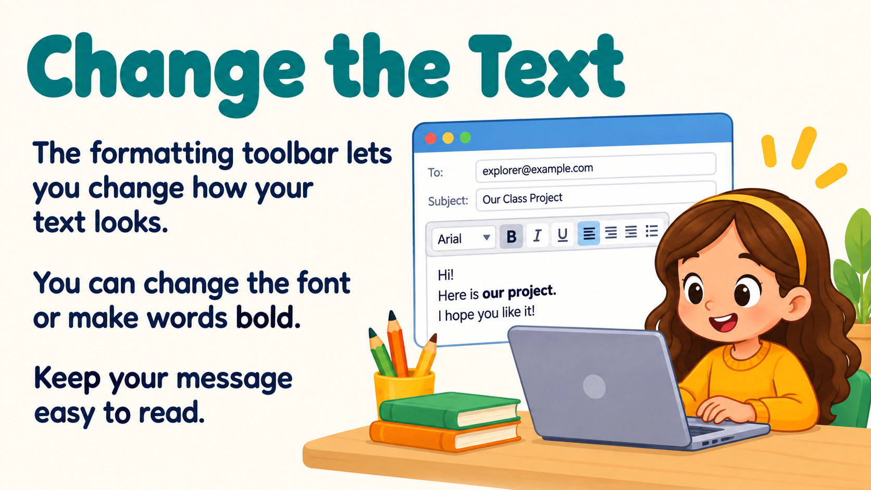
Notes:
Source: Oxford International Primary Computing Student Book 3, Unit 2 Digital literacy: Explorers, section 2.3 Send an email, printed pages 26–27, and section 2.4 Open an email, pages 28–29. Classroom adaptation. Illustrations are generated teaching examples. Practice address example.com is illustrative only.

Slide 13
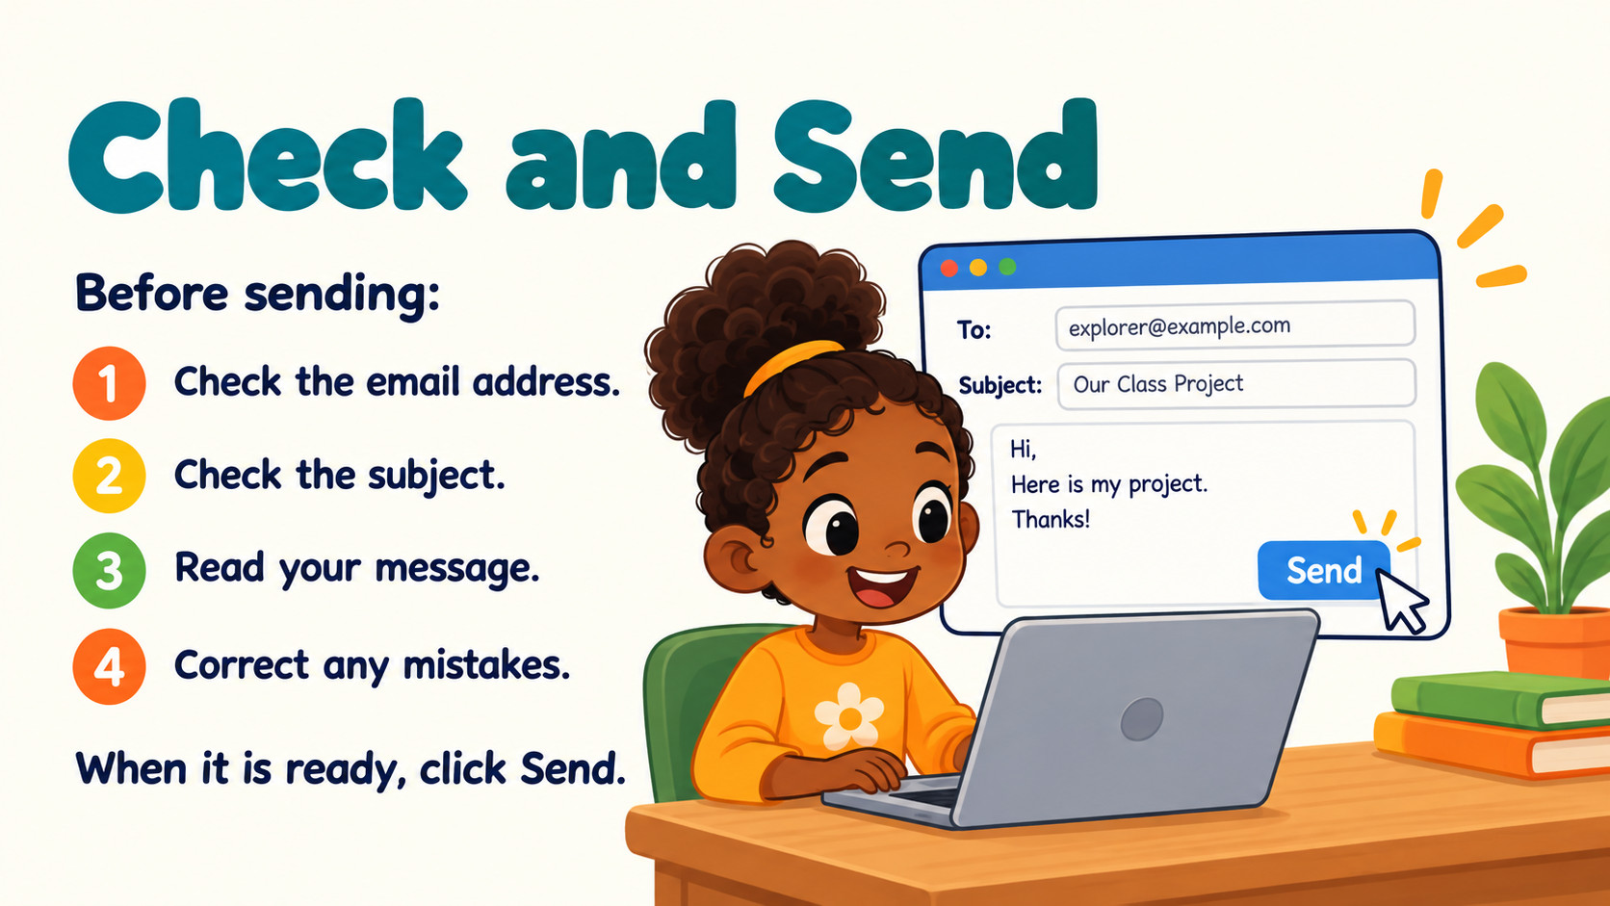
Notes:
Source: Oxford International Primary Computing Student Book 3, Unit 2 Digital literacy: Explorers, section 2.3 Send an email, printed pages 26–27, and section 2.4 Open an email, pages 28–29. Classroom adaptation. Illustrations are generated teaching examples. Practice address example.com is illustrative only.

Slide 14
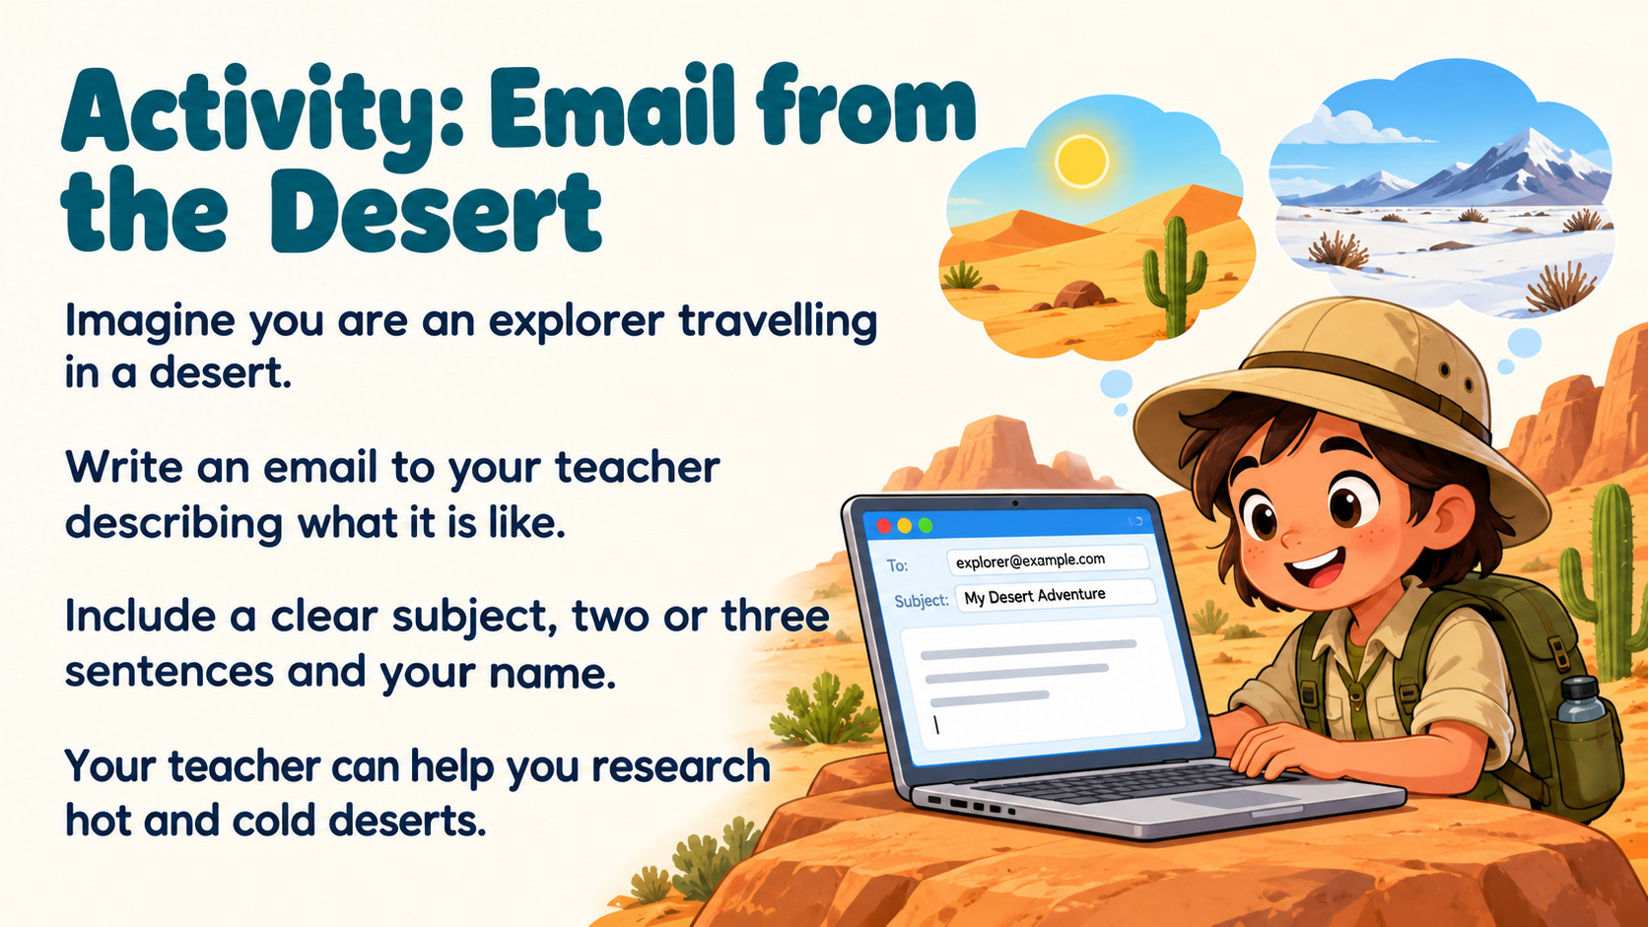
Notes:
Source: Oxford International Primary Computing Student Book 3, Unit 2 Digital literacy: Explorers, section 2.3 Send an email, printed pages 26–27, and section 2.4 Open an email, pages 28–29. Classroom adaptation. Illustrations are generated teaching examples. Practice address example.com is illustrative only.

Slide 15
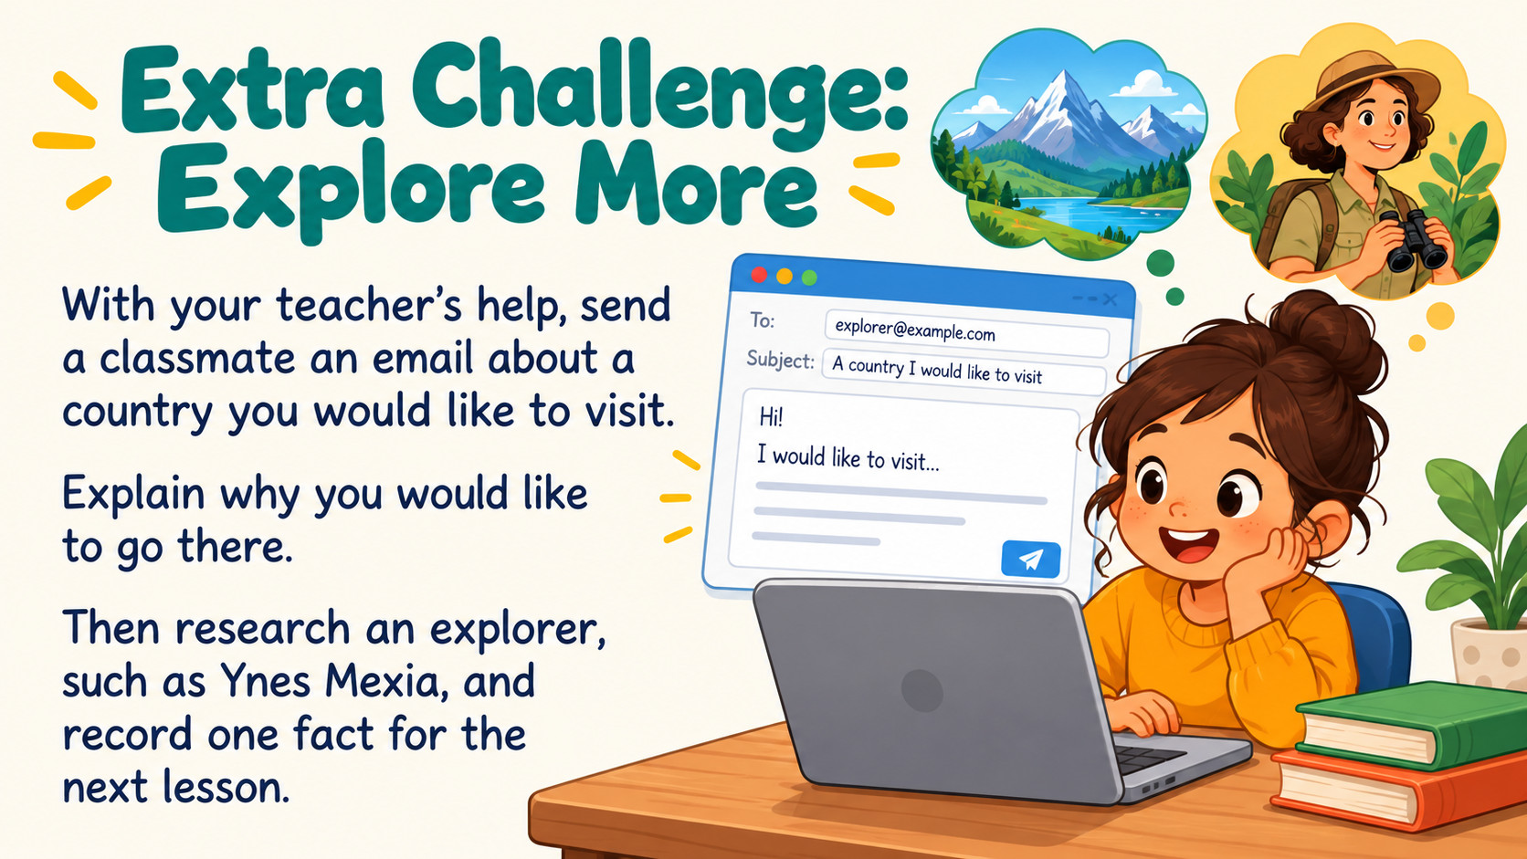
Notes:
Source: Oxford International Primary Computing Student Book 3, Unit 2 Digital literacy: Explorers, section 2.3 Send an email, printed pages 26–27, and section 2.4 Open an email, pages 28–29. Classroom adaptation. Illustrations are generated teaching examples. Practice address example.com is illustrative only.

Slide 16

Notes:
Source: Oxford International Primary Computing Student Book 3, Unit 2 Digital literacy: Explorers, section 2.3 Send an email, printed pages 26–27, and section 2.4 Open an email, pages 28–29. Classroom adaptation. Illustrations are generated teaching examples. Practice address example.com is illustrative only.

